Slide 1
Web Accessibility
By Megan Steinmasel and Michael Belmear

Slide 2
What is Web Accessibility?
Formal Definition
Web accessibility is the inclusive practice of ensuring there are no barriers that prevent interaction with, or access to, websites on the World Wide Web by people with physical disabilities, situational disabilities, and socio-economic restrictions on bandwidth and speed.
Web accessibility encompasses all disabilities that affect access to the web, including:
Auditory
Cognitive
Neurological
Physical
Speech
Visual

Slide 3
Who Manages Web Accessibility?
There is no enforceable law related to Web Accessibility, except for government websites.
In the case of a government website, the Section 508 of the Rehabilitation Act must be abided.
Just because there is not a formal law related to Web Accessibility, does not mean businesses should avoid it.
Gil v. Winn-Dixie decision
Ruled that websites may constitute public accommodations under ADA.
Domino’s Pizza v. Guillermo Robles
A court ruled in favor of Robles, a blind man who could not order food through Dominos website and app.
Web Accessibility Initiative (WAI)
WAI is responsible for the Web Content Accessibility Guidelines (WCAG).

Slide 4
Semantics - HTML5
Semantic HTML refers to the use of HTML tags that convey the meaning of the content contained within them.
By adding semantic HTML tags to your pages, you provide additional information that helps define the roles and relative importance of the different parts of your page.
Accessibility
For sighted users, it is easy to find the headers, footers, articles, or any other section on a webpage because it is visually apparent.
However, it is not that easy for blind users who use screen readers.
Semantic tags are also important for search engine optimization.
Semantic HTML Cheat Sheet

Slide 5
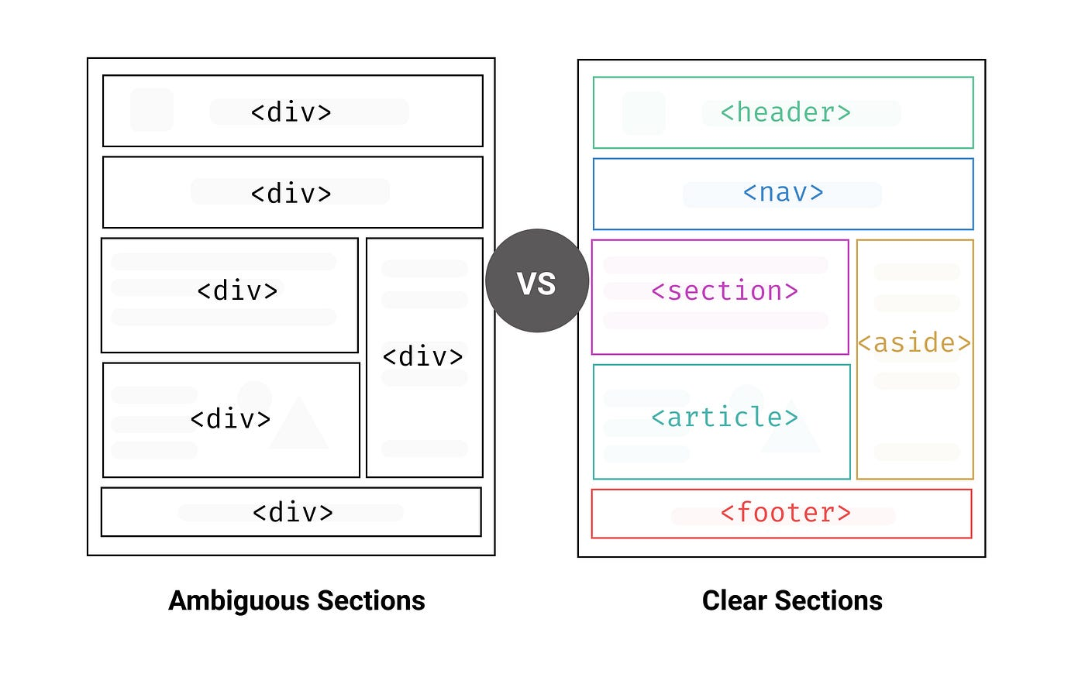
Semantics

Slide 6
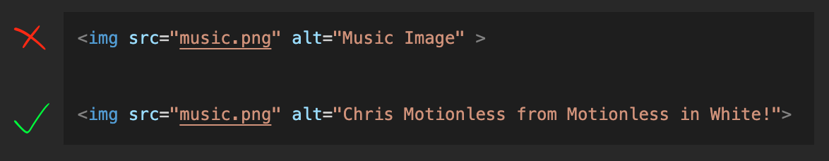
Text Alternatives
Descriptive text alternatives ensure everyone can benefit from the content you share.
Alt text helps screen-reading tools describe images to visually impaired readers and allows search engines to rank your website higher.
Say a user has a poor internet connection, so the images on a webpage don’t load. Instead of just seeing a broken link icon, they’ll also see alternative text to gather what the image conveys.
Make sure your alternative text describes the meaning of image.

Slide 7
Keyboard Accessibility & Navigation
Keyboard accessibility is important to make sure all users have access to information without requiring a mouse/trackpad.
Users whom rely on keyboard navigation include: blind or low vision, temporary or permanent mobile disabilities, and users with no access to a mouse/trackpad.
To be keyboard accessible, a website must incorporate appropriate tab order and avoid keyboard traps.
The tab order should follow the flow of the webpage: left to right and top to bottom.
Tab order can be applied through the tabindex attribute.
tabindex=“0” adds element to the natural focus order and is focusable through the keyboard.
tabindex=“-1” makes element focusable using scripting.
tabindex=“1” or higher should not be used because normal tab flow will be broken.

Slide 8
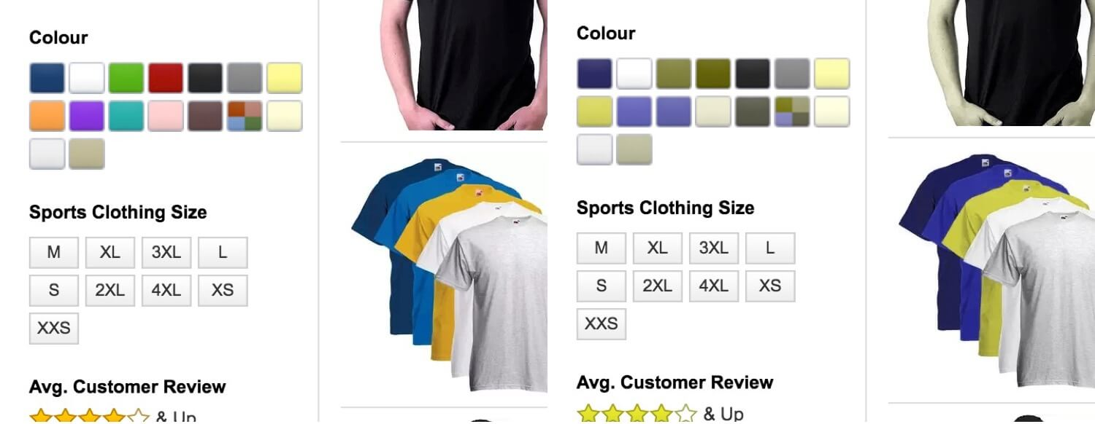
Color Blindness
Color blindness accessibility ensures that users who can't differentiate color can still use and experience a webpage.
Red-green color blindness affects around 8% of males and 1% of females.
Without descriptive text or labels, a user who is red-green color blind cannot properly order.

Slide 9
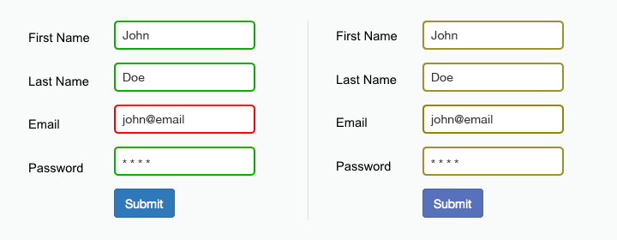
Color Blindness
Don’t rely on only color for error messages, especially in large form fields.
Fix this mistake by adding an error icon or descriptive text.

Slide 10
Keep in Mind - Assistive Technologies
Screen magnifiers
Screen readers
Text-to-speech software
Used to convert text to synthetic speech
Speech recognition software
Used to allow spoken control
Keyboard simulators
Head pointers, on-screen keyboards, and single switches, used to simulate a keyboard
Mouse simulators
Pointing devices used to simulate mouse pointing and clicking

Slide 11
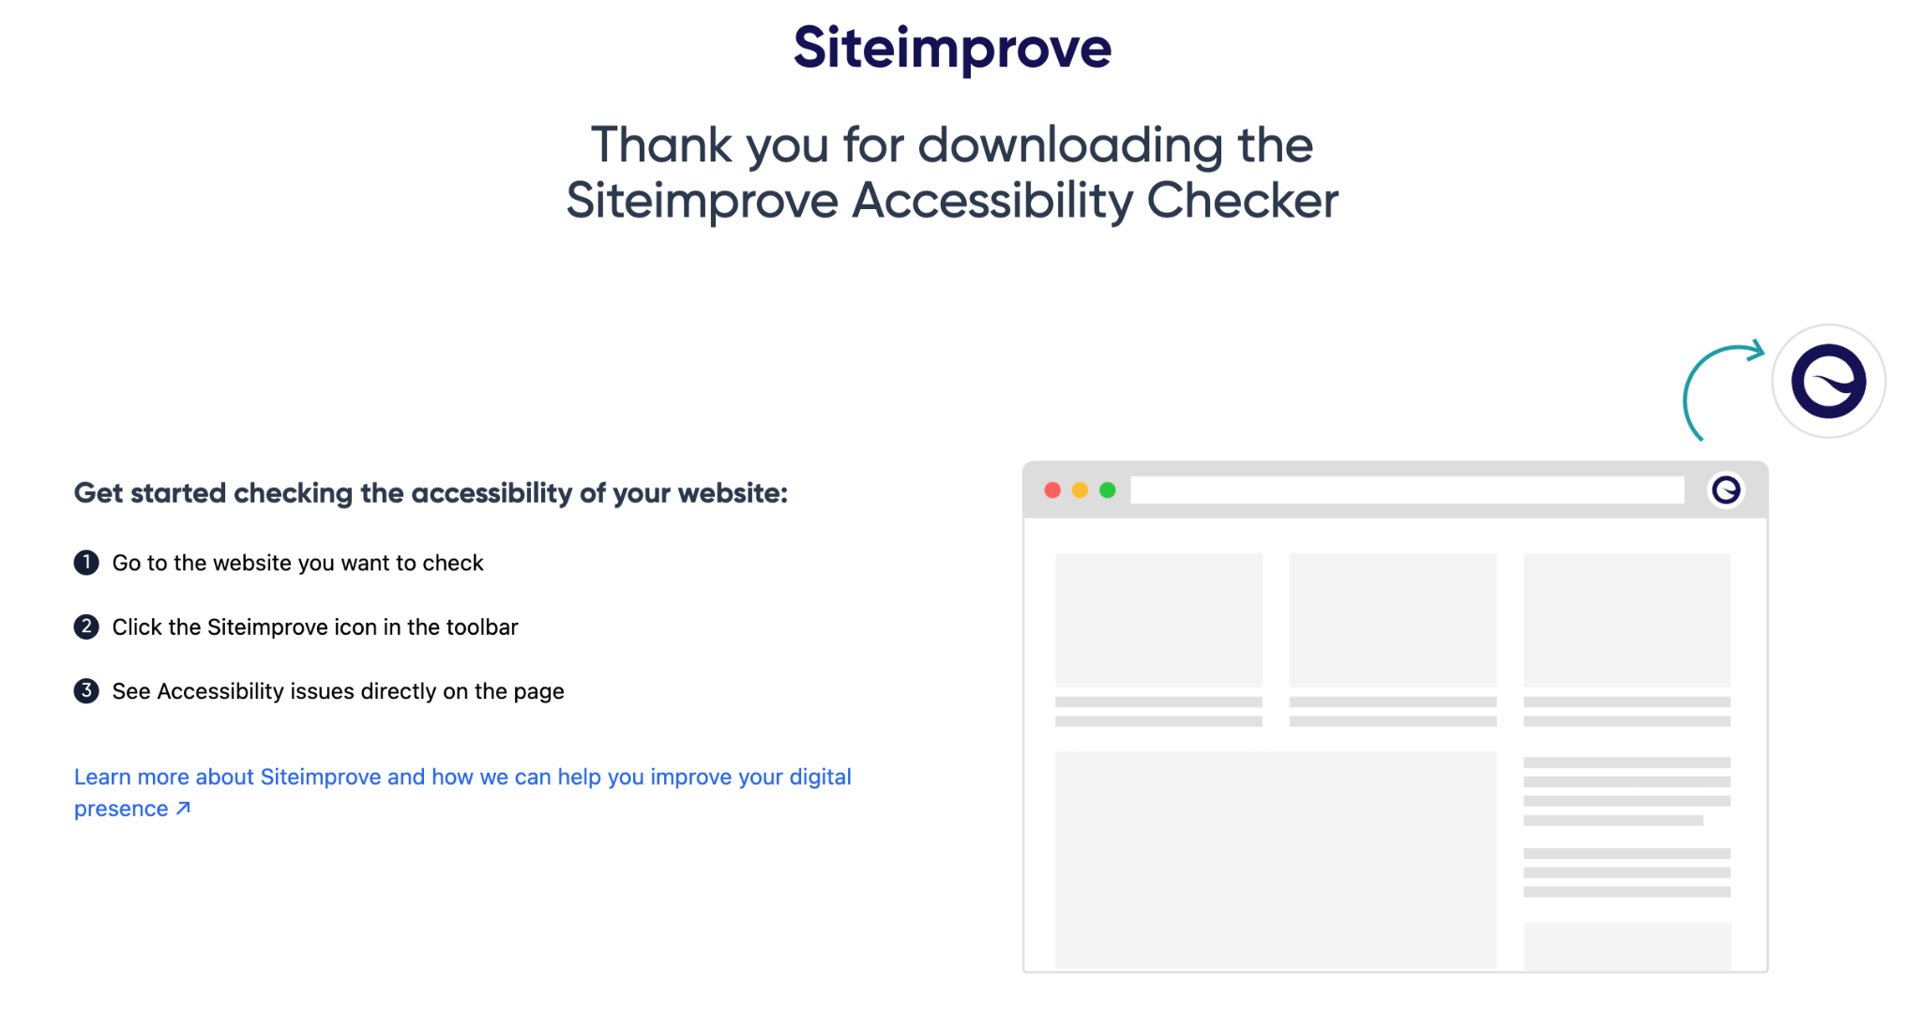
Accessibility Checkers
Validators
W3C Markup Validation Service
Accessibility Checkers
There are several on the market, we chose the Siteimprove Accessibility Checker Chrome Extension
Siteimprove Accessibility Checker checks if a web page is ADA accessible

Slide 12

Demo 1

Slide 13
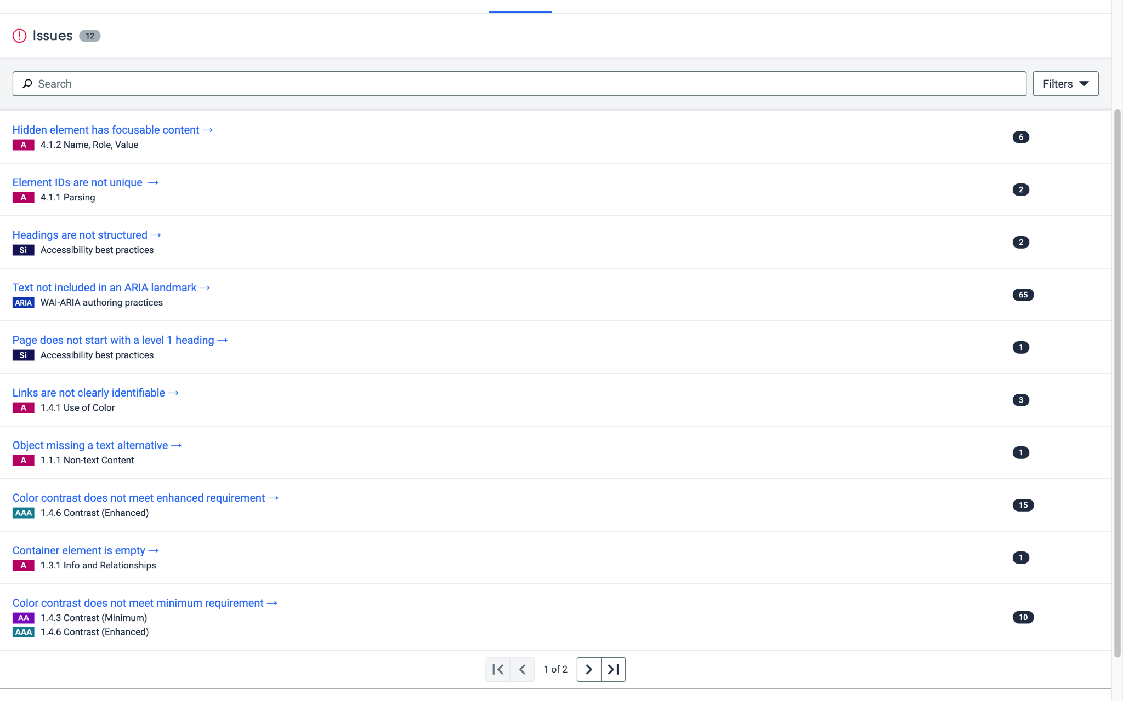
Demo 1
❌

Slide 14
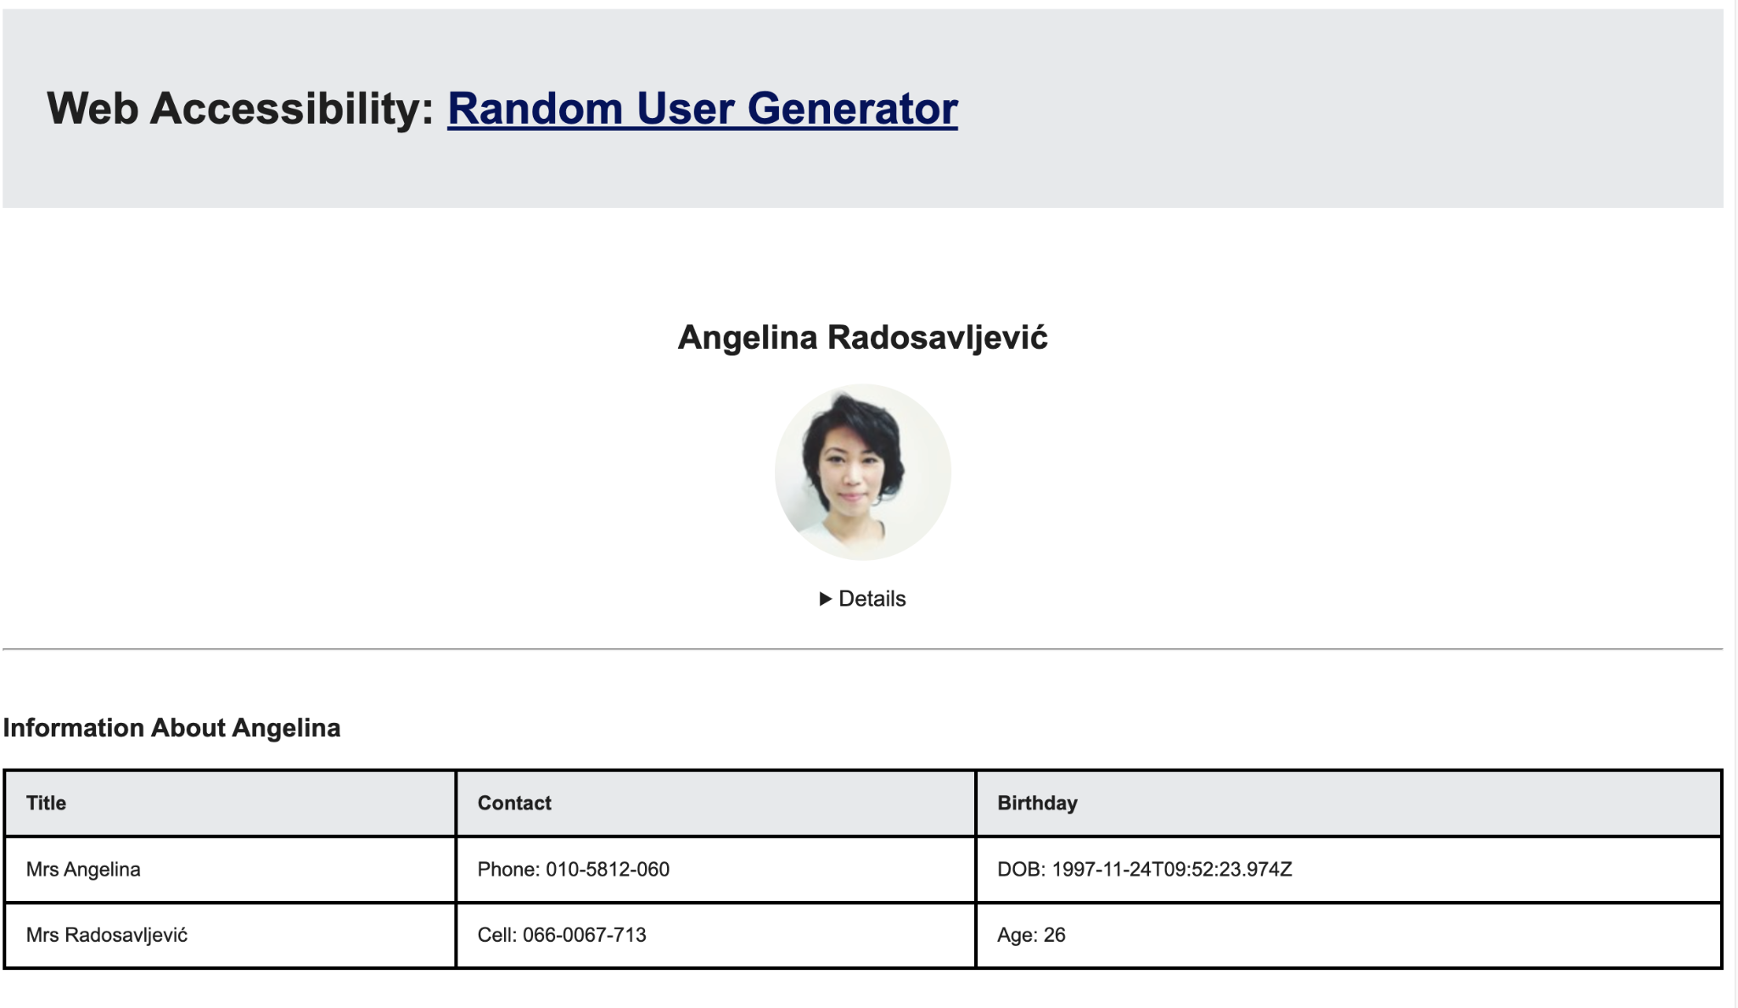
Demo 2
https://csci331.cs.montana.edu/~n56t363/final/
https://mbelmear.github.io/CSCI-331/Final%20Project/

Slide 15
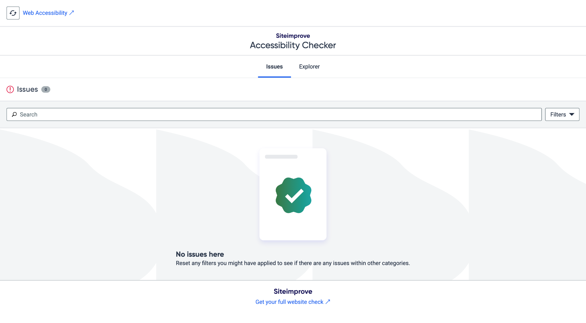
Demo 2
✅

